Slide 1











Tobago Secondary School
Directory
Presented by
Student Support Services Unit
Division of Education, Research and Technology
Notes:
School crests: https://thadeie.gov.tt/schools/

Slide 2
Table of Contents
01
02
Introduction
General Requirements
03
04
Bishop’s High School
Goodwood Secondary School
Welcome to the Tobago Secondary School Directory
What you need to know about starting High School
Crede Cruci
(Believe in the Cross)
Discipline Nurtures Development

Slide 3
05
06
Harmon School of S.D.A
Mason Hall Secondary School
07
08
Pentecostal Light & Life Foundation High School
Roxborough Secondary School
Nihil Sine Numine
(Nothing without Providence)
Determination, Excellence: Our keys to success
More than Conquerors
Love and Service

Slide 4
09
10
Scarborough Secondary School
Signal Hill Secondary School
11
12
Speyside High School
Credits
Committed to Excellence
Readiness is the Key
Diligence creates excellence
Thank you!

Slide 5
Introduction
Your dream is now a reality!
Are you ready for Secondary School?

Slide 6
Welcome, Future High School Student!
Deciding which secondary school should be your first or second choice is one of the most important decisions you will have to make. Are you hoping to attend the school that your parents or siblings attended? Do you want to play football, cricket or join the Cadets or Drama Guild? Well, this directory will give you the information you need about the programs and activities available in Tobago’s Secondary Schools so that you can make an informed decision when making your secondary school choices.
Parents please note: School choice forms should be filled out along with SEA registration and submitted within the first term.

Slide 7
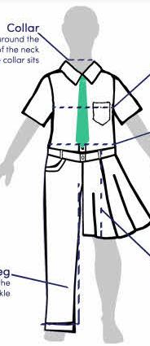
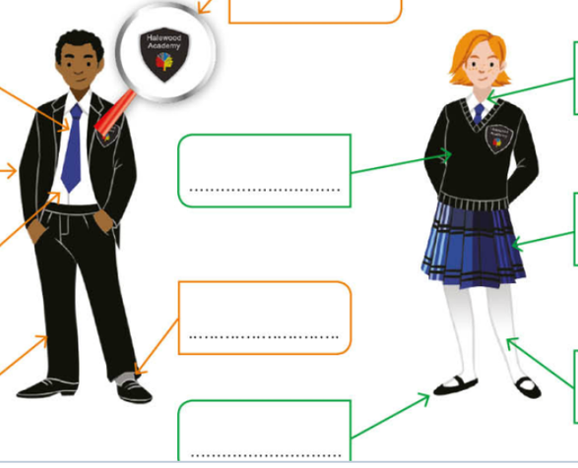
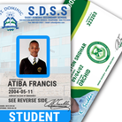
General Secondary School Requirements
# 1
# 2
Adherence to school uniform guidelines is essential in maintaining the public image of your school.
School identification badge is to be displayed on the uniform shirt. Most schools will only allow students with a visible student badge on the compound.

Slide 8
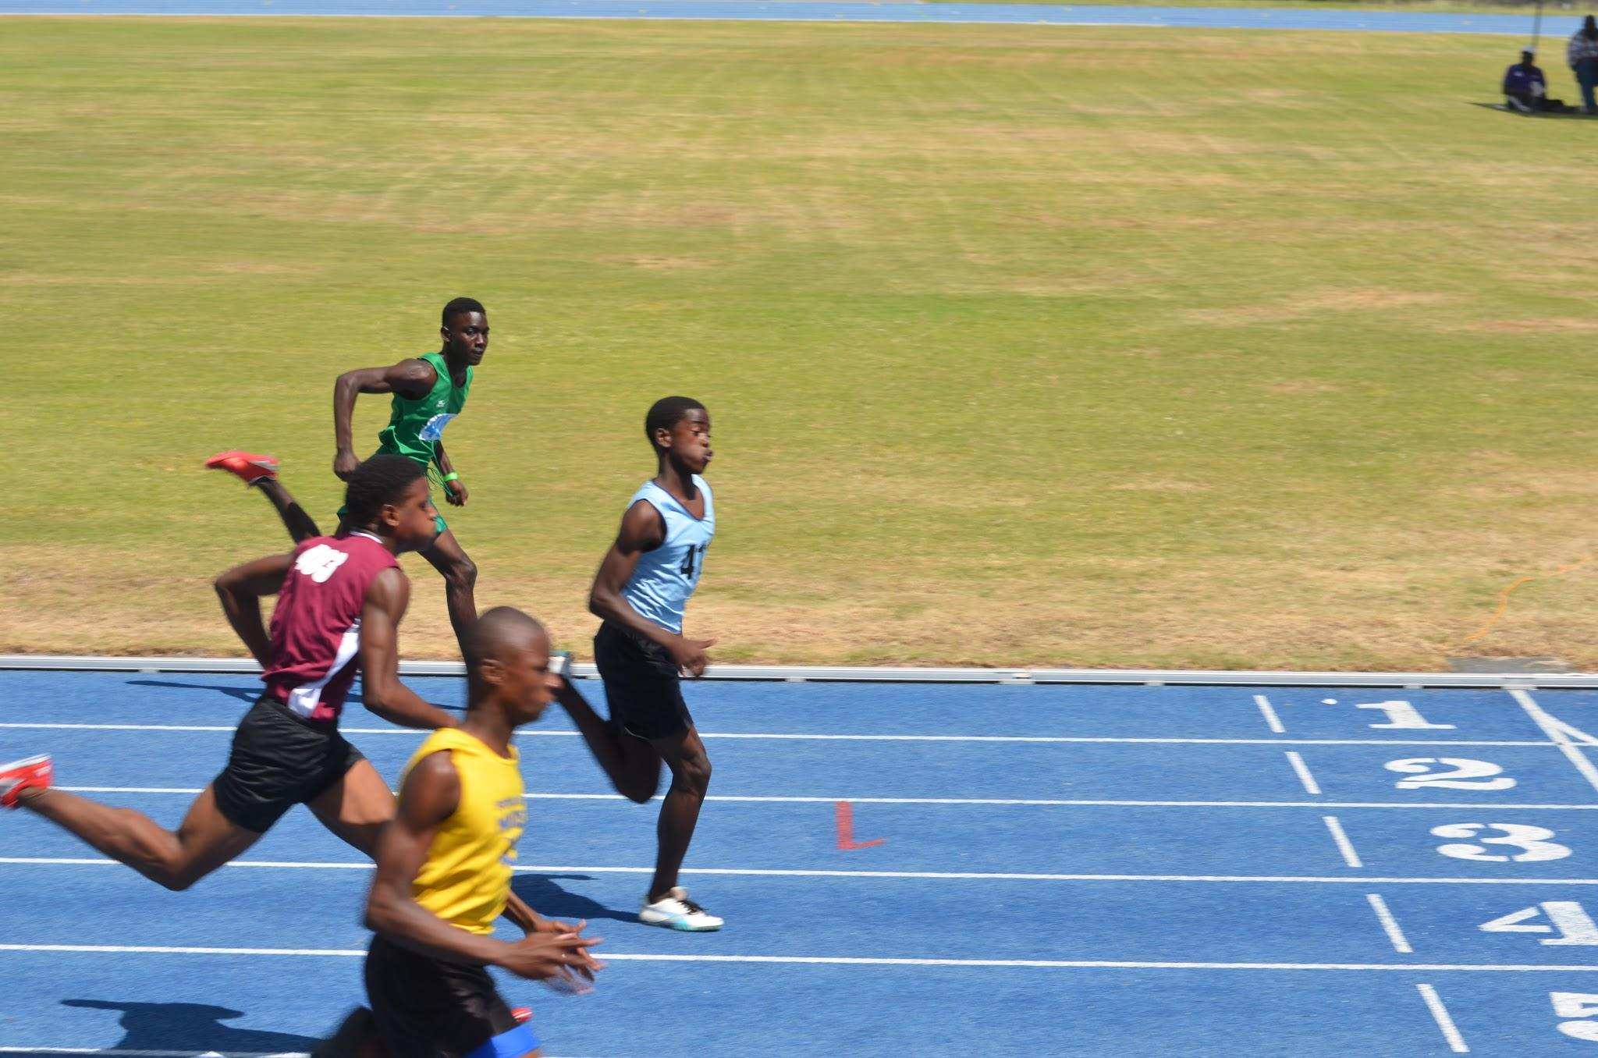
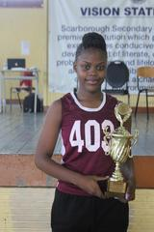
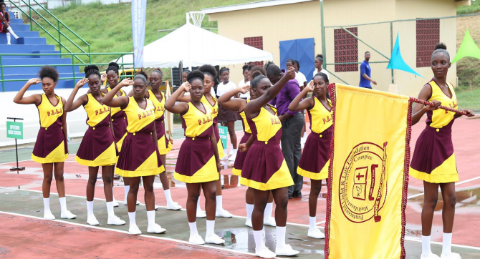
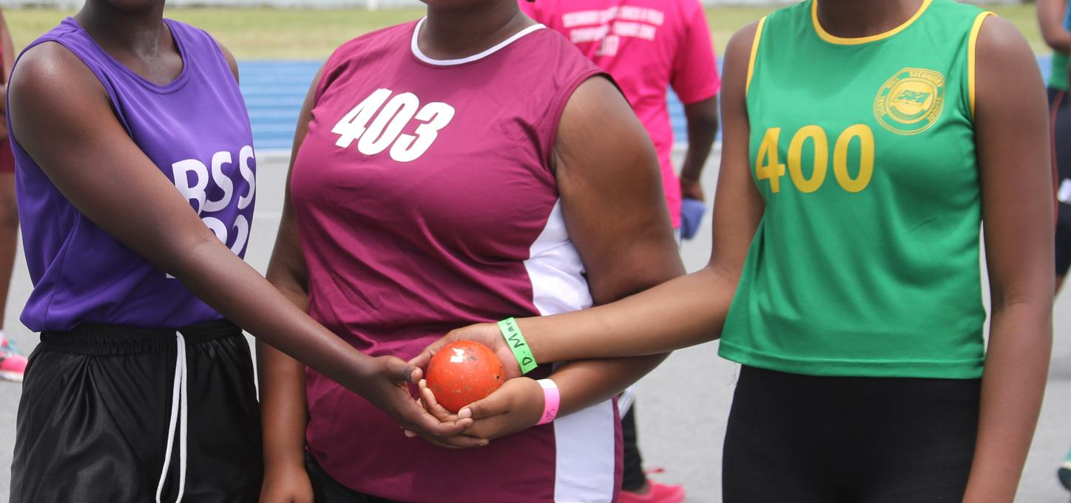
# 3
Participation in Physical Education classes is mandatory. A student may be exempted with a medical certificate or written excuse from his/her parent or guardian.

Slide 9

School Profiles

Slide 10
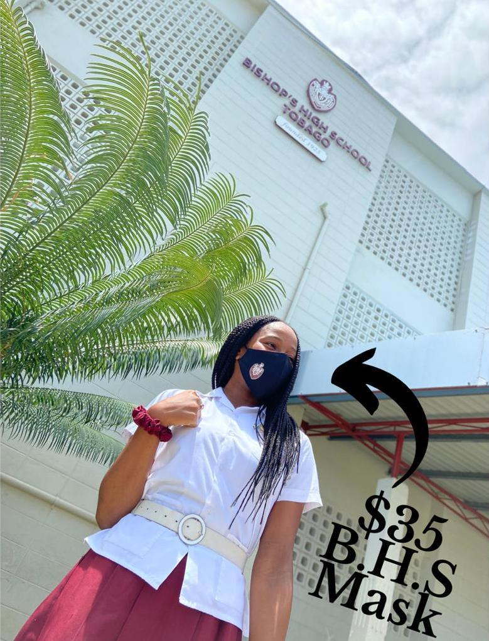
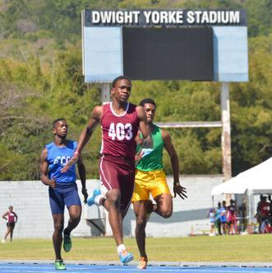
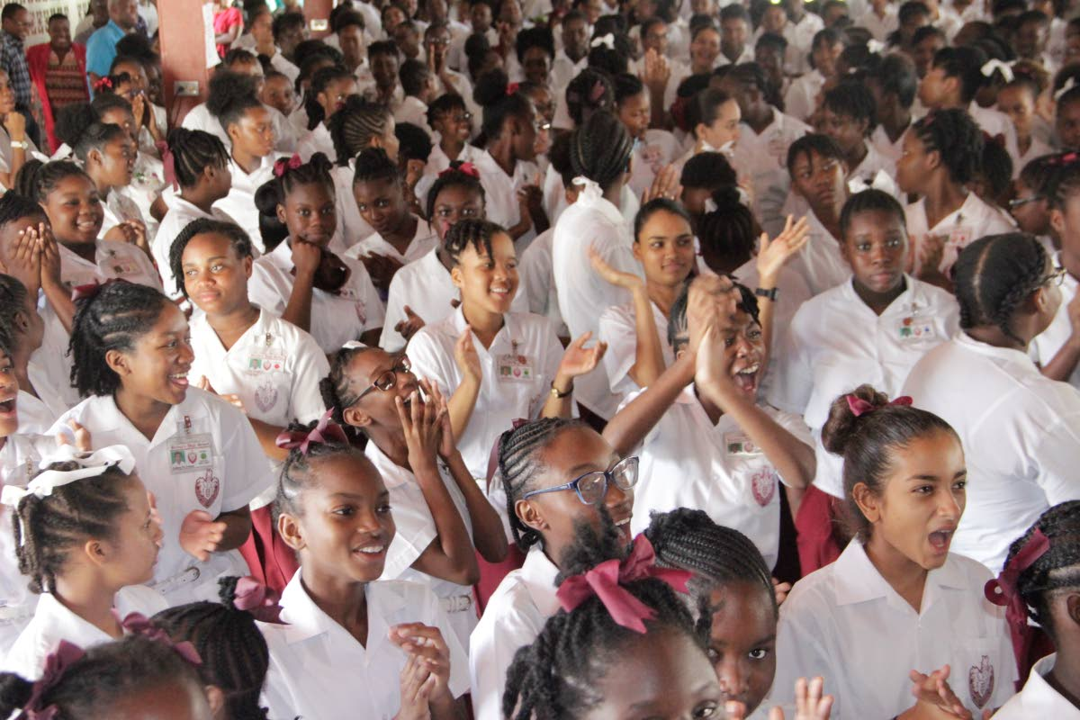
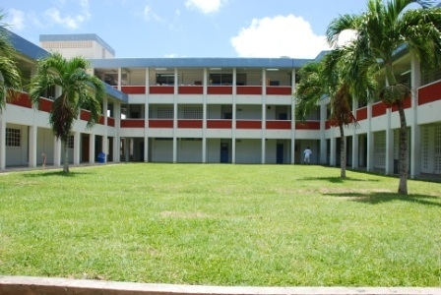

Slide 11



Bishop’s High School
Principal
Vice Principal
Mission
Online Presence
Mount Marie Road,
Scarborough, Tobago
Telephone: (868) 639-2534
Established 1925
Miss Cindy Ramnarine
Mrs Suzette James-Stewart
To develop well-rounded students by providing them with a broad academic curriculum and a wide range of co-curricular activities. The school is ever mindful of its creed 'Crede Cruci' and thus demands excellence and the exercise of the highest moral and spiritual values

Slide 12
Academic Curriculum
Mathematics (Forms 1 - 5)
English Language (Forms 1 - 5)
English Literature (Forms 1 - 5)
Spanish (Forms 1 - 5)
French (Forms 1 – 5)
Social Studies (Forms 1 – 5)
Integrated Science (Forms 1 - 3)
Physical Education (Forms 1 - 5)
Visual Arts (Forms 1 -5)
Theatre Arts (Forms 4 & 5 only)
Music (Forms 1 - 5)
Technology Education (Forms 1 - 5)
Geography (Forms 3,4 & 5 only)
Biology (Forms 4 & 5 only)
Chemistry (Forms 3 - 5 only)
Physics (Forms 3 - 5 only)
Information Technology (Forms 1 - 5)
Principles of Business (Forms 3 -5 only)
Principles of Accounts (Forms 4 & 5 only)
Food and Nutrition (Forms 1 - 5)
Technical Drawing (Forms 1 - 5)
Electrical Installation (Forms 4 & 5 only)
History (Forms 2, 4 & 5 only)

Slide 13
Extras
01
English Language, English Literature, Mathematics, a Science and a Foreign Language are compulsory, with a total of 8 subjects in Forms 4 & 5.
02
Bishop’s High School, Tobago is a leading educational institution in our nation and has produced many outstanding alumni in its ninety-five (95) years of service.
Bishop’s House System is a deep-rooted, fiercely guarded tradition of the school that is well-known across Tobago, even by non-Bishopians.
03
School’s Motto: The school is ever mindful of its creed 'Crede Cruci' and thus demands excellence and the exercise of the highest moral and spiritual values.
04

Slide 14

Guess who attended Bishop’s High School!
Jerome Lawrence, International Pilot
1
Mark London,
National Athlete
2
Sekani Solomon,
Motion Designer
3
Notes:
Jerome Lawrence: https://www.youtube.com/watch?v=DKMO1Hrij54
Sekani Solomon: https://www.youtube.com/watch?v=RenJugHhZsA

Slide 15
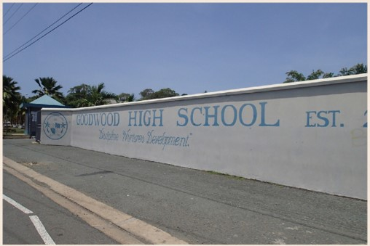
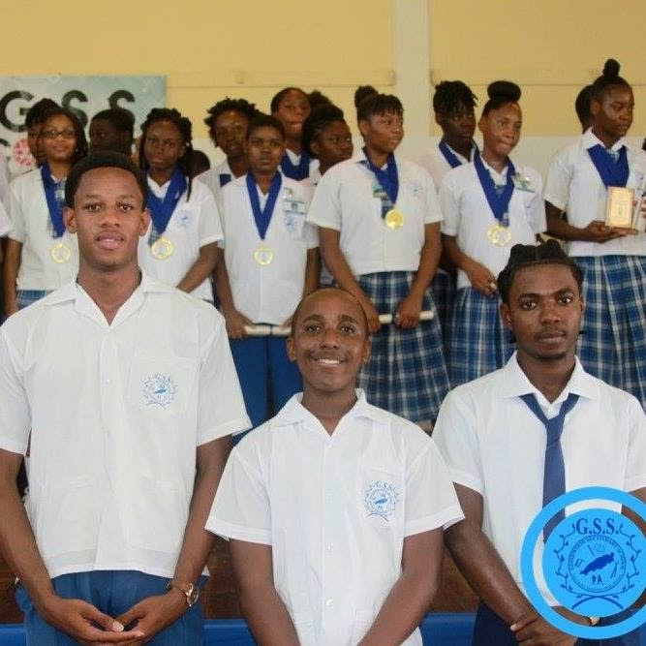

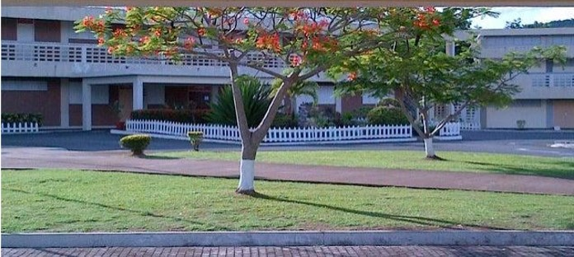

Slide 16
Goodwood Secondary School
Principal
Vice Principal
Mission
Online Presence
Windward Road
Goodwood, Tobago
Telephone: (868) 635-1541
Established 2003
Mrs Sherra Carrington-James
Miss Karen Jones
(1) To provide an education that encourages the development of the arts, academics and technological skills.
(2) To guide students along a holistic path to self-actualization and positive societal contribution in an ever-changing world.

Slide 17
Academic Curriculum
Mathematics (Forms 1 - 5)
English Language (Forms 1 - 5)
English Literature (Forms 1 - 5)
Spanish (Forms 1 - 5)
Social Studies (Forms 1 – 5)
Integrated Science (Forms 1 - 5)
Physical Education (Forms 1 - 5)
Visual Arts (Forms 1 -5)
Performing/Theatre Arts (Forms 1 - 5)
Music (Forms 1 - 5)
Dance (Forms 1 – 5)
Technology Education (Forms 1, 2 & 3 only)
Geography (Forms 3,4 & 5 only)
Agricultural Science (Forms 4 & 5 only)
Biology & Human and Social Biology (Forms 4 & 5 only)
Chemistry (Forms 4 & 5 only)
Physics (Forms 4 & 5 only)
Information Technology (Forms 4 & 5 only)
Electronics (Forms 4 & 5 only)
Economics (Forms 4, 5 & 6 only)
Principles of Business and Principles of Accounts (Forms 4 & 5 only)
Food and Nutrition (Forms 4 & 5 only)
Clothing and Textile (Forms 4 & 5 only)
Technical Drawing (Forms 4 & 5 only)
Accounting (Form 6 only)
Caribbean Studies (Form 6 only)
Communication Studies (Form 6 only)
Environmental Science (Form 6 only)
Law (Form 6 only)
Management of Business (Form 6 only)
Sociology (Form 6 only)

Slide 18
Extras
Goodwood Secondary School was established as a magnet school for Visual and Performing Arts (VAPA), a status it still maintains.
01
02
Goodwood Secondary School has a Sixth Form program.
03
School’s Vision: To nurture young adults to be responsible, knowledgeable and suitably skilled to contribute productively to the society in which they live.
04
School’s Motto: Discipline nurtures development
Notes:
Magnet School - a school designed to attract pupils from various areas or groups, especially one offering specialist tuition in a particular subject alongside the standard curriculum.

Slide 19

Guess who attended Goodwood Secondary School
Daneil Cyrus, Professional Footballer
1
Rundell Winchester,
Professional Footballer
2
Diana Quashie,
Entrepreneur, Model
3

Slide 20
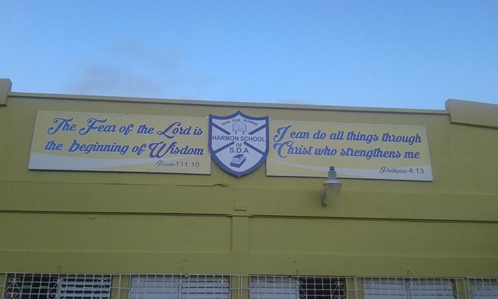
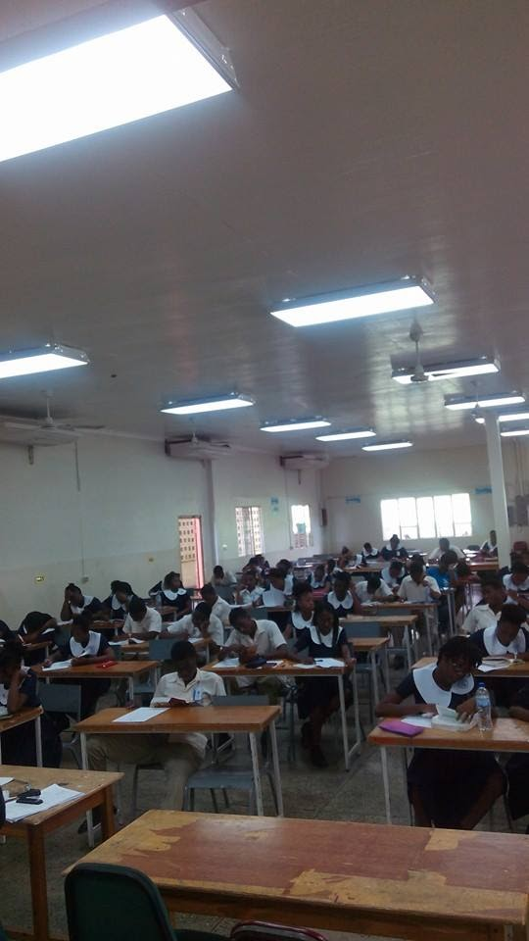
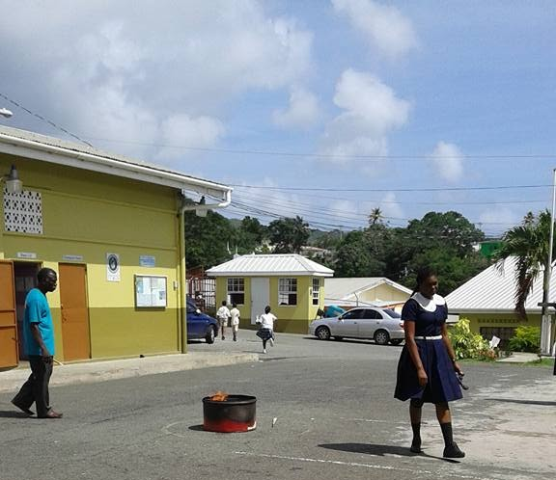
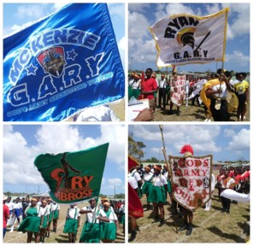

Slide 21
Harmon School of Seventh Day Adventist
Principal
Vice Principal
Mission
Online Presence
Rockley Vale
Scarborough, Tobago
Telephone: (868) 639-2592
Established 1952
Mrs. Shennel Ross-Ottley
Mr. Ken Mapp
As a Christian Educational Institution we are committed to prepare young leaders to be life-long learners, patriotic citizens for this earth and for the new earth. This will be done through the modelling of Christian values that will allow them to serve God and others.

Slide 22
Academic Curriculum
Bible (Forms 1-5)
Mathematics (Forms 1 - 5)
English Language (Forms 1 - 5)
English Literature (Forms 1 - 5)
Spanish (Forms 1 - 5)
Social Studies (Forms 1 – 5)
Integrated Science (Forms 1 - 5)
Physical Education (Forms 1 - 5)
Visual Arts (Forms 2 - 5)
Theatre Arts (Forms 1 - 5)
Music (Forms 1 - 5)
Health and Family Life Education (Forms 1-3)
Technology Education (Forms 1 - 3)
Geography (Forms 3, 4 & 5 only)
Agricultural Science (Forms 1, 2, 4 & 5 only)
Biology & Human and Social Biology (Forms 4 & 5 only)
Chemistry (Forms 3 - 5 only)
Physics (Forms 3 - 5 only)
Information Technology (Forms 4 & 5 only)
Information and Communications Technology (1 – 3 only)
Electronic Document Preparation and Management (Forms 4 & 5 only)
Office Administration (Forms 4 & 5 only)
Principles of Business and Principles of Accounts (Forms 4 & 5 only)
Food and Nutrition (Forms 4 & 5 only)
Technical Drawing (Forms 4 & 5 only)
Electrical Installation (Forms 4 & 5 only)
Mechanical Engineering Technology (Forms 4 & 5 only)
History (Forms 4 & 5 only)
Religious Education (Forms 4 & 5 only)

Slide 23
Extras
01
Extracurricular Activites: Retreat, Student Council, Prefect, Pathfinder Club, Language Club, Maths Camp
02
In 2014, Tobago's highest S.E.A topper 11-year-old, Jevaughn Bruce made Harmon School of S.D.A his choice for secondary education.
03
Harmon School of S.D.A. is one of four Seventh-day Adventist high schools in Trinidad and Tobago and the only one on the island of Tobago.
04
The school was named after one of the founders of the Seventh-day Adventist Church, Ellen G. White. Her maiden name was Harmon.

Slide 24
Guess who attended Harmon School of S.D.A!
Atiba Wright, National Track & Field Athlete
1
WPC Rheanne Moore,
Youth Activist
2
Blessed Messenger,
Gospel Artiste
3

Slide 25
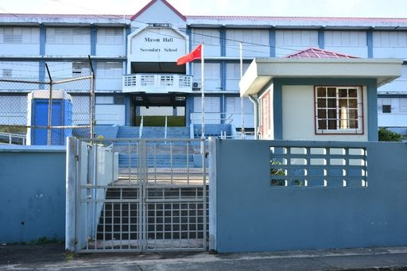
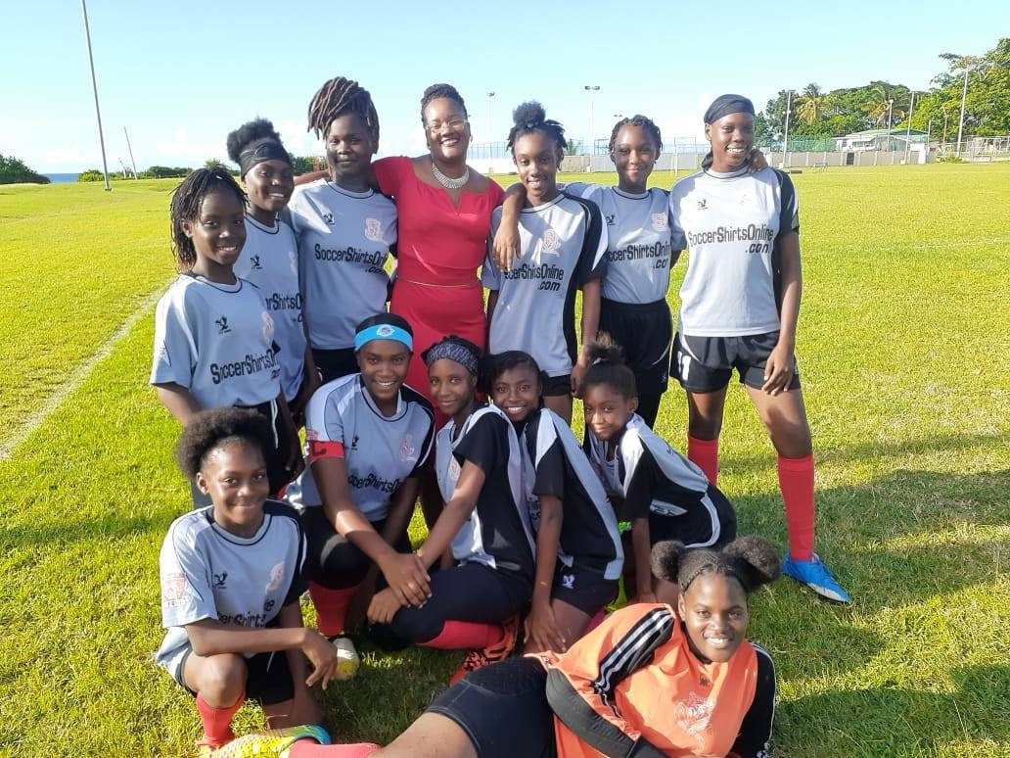

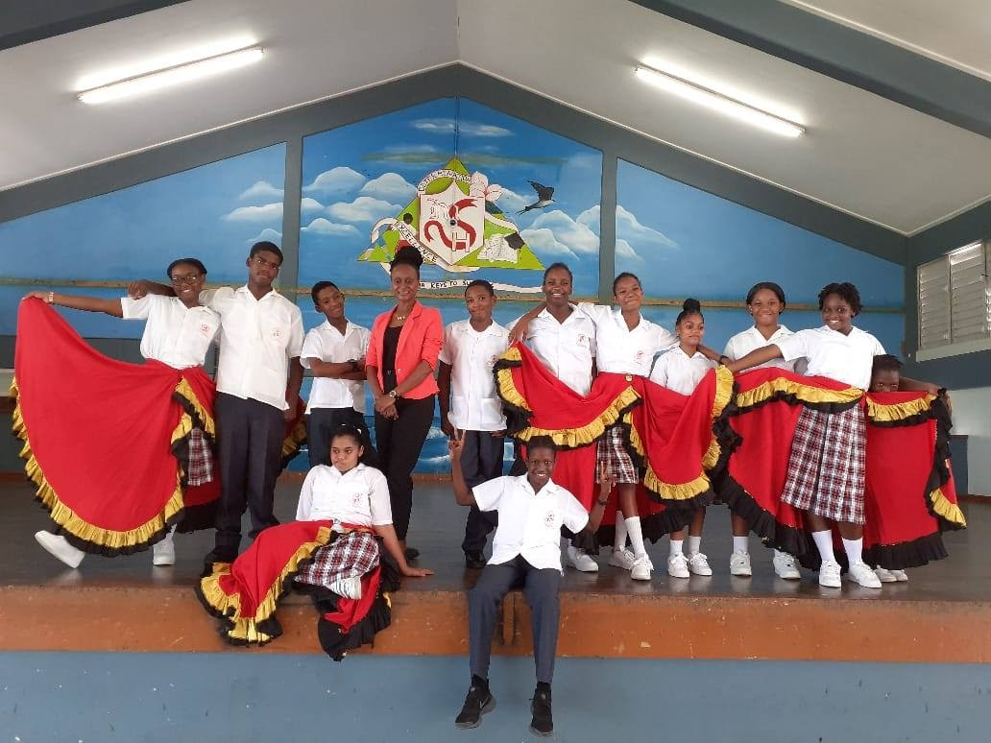
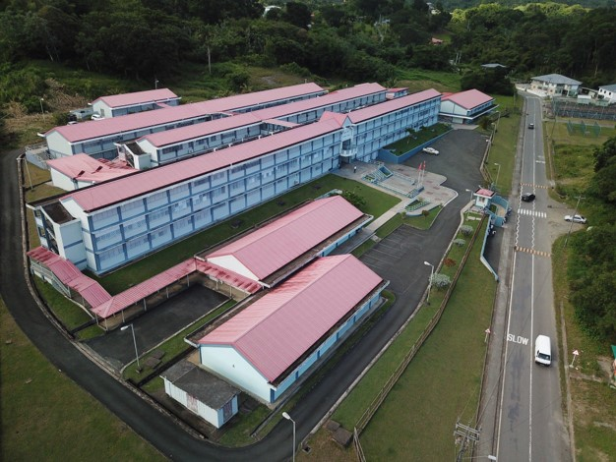

Slide 26
Mason Hall Secondary School
Principal
Vice Principal
Mission
Online Presence
2-8 Punch Bowl Sandy River
Mason Hall, Tobago
Telephone: (868) 635-0449/(868) 635-0809
Established 2003
Ms. Suanne Demas
Mrs Frith Dates
To empower students of all background to achieve their full intellectual and social potential by providing a multi-curricula, student-centered environment in which students will be held to high academic and behavioural standards, thus becoming literate, self-motivated, life-long learners who can function effectively in a rapidly changing world.

Slide 27
Academic Curriculum
Mathematics (Forms 1 - 5)
English Language (Forms 1 - 5)
English Literature (Forms 1 - 5)
Spanish (Forms 1 - 5)
Social Studies (Forms 1 – 5)
Integrated Science (Forms 1 - 5)
Physical Education (Forms 1 - 5)
Visual Arts (Forms 1 -5)
Theatre Arts (Forms 1 - 5)
Music (Forms 1 - 5)
Technology Education (Forms 1, 2 & 3 only)
Geography (Forms 3,4 & 5 only)
Agricultural Science (Forms 4 & 5 only)
Biology & Human and Social Biology (Forms 4 & 5 only)
Chemistry (Forms 4 & 5 only)
Physics (Forms 4 & 5 only)
Information Technology (Forms 4 & 5 only)
Electronic Document Preparation and Management (Forms 4 & 5 only)
Office Administration (Forms 4 & 5 only)
Principles of Business and Principles of Accounts (Forms 4 & 5 only)
Food and Nutrition (Forms 4 & 5 only)
Technical Drawing (Forms 4 & 5 only)
Electrical Installation (Forms 4 & 5 only)
Mechanical Engineering Technology (Forms 4 & 5 only)
History (Forms 4 & 5 only)

Slide 28
Extras
Vision: To provide a nurturing educational environment where each child can achieve his potential in becoming a productive citizen of the society.
01
02
Motto: Determination, Excellence: Our Keys to Success
03
MHS Lions: We are the MHS Lions and as a pride, we care for one another, respect one another and support one another.
04
A few of the clubs available are: The Environmental Club, MHS Honours Society, MHS Tourism Club, and MH Network Academy.

Slide 29
Guess who attended Mason Hall Secondary School!
Javanne Williams, Entrepreneur, Grade A Cuts
1
Kyle “Squad-D” Arnold,
Singer
2
Adana Roberts,
Recording Artiste,
Radio Personality
3

Slide 30
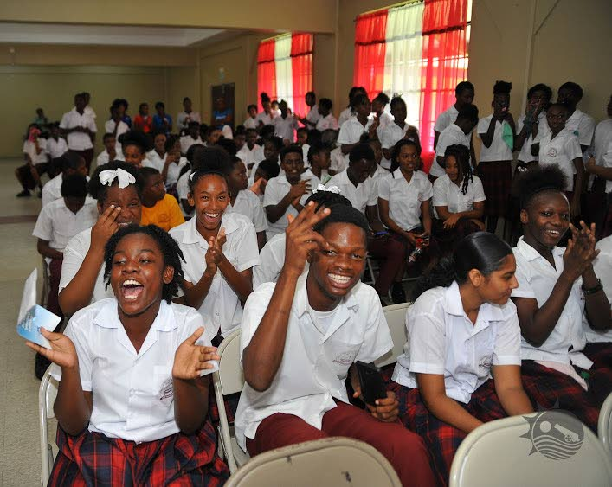
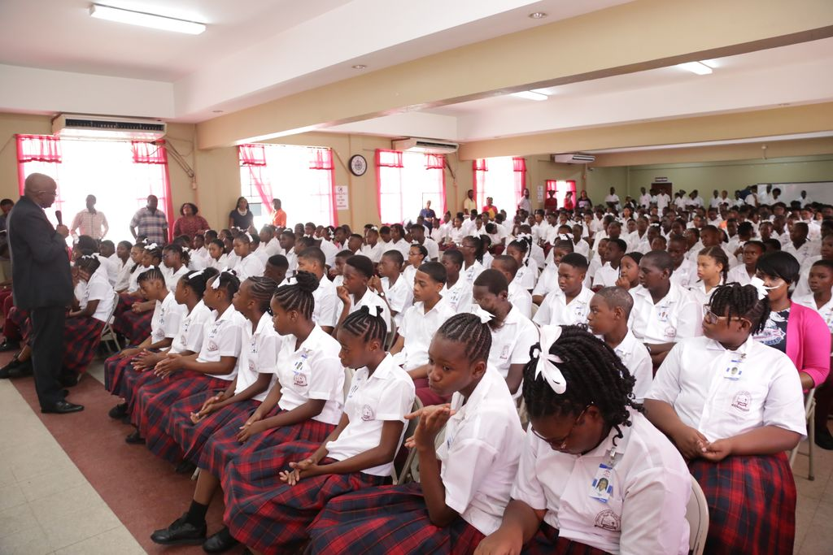
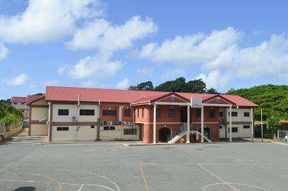
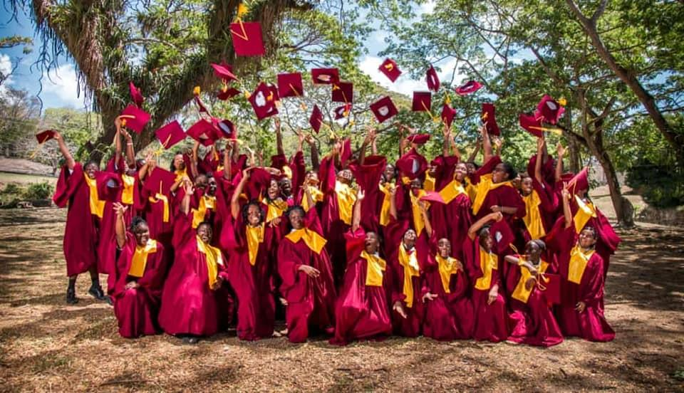

Slide 31
Pentecostal Light and Life Foundation High School
Principal
Vice Principal
Mission
Online Presence
#70 Sangster Hill Road
Scarborough, Tobago
Telephone: (868) 639-2596
Established 2001
Mr Kurt London (actg)
Ms Thakurani Cassie
(actg)
To develop well-rounded citizens through providing a wide range of academic and co-curricular programs within a caring and supportive environment, which emphasizes spiritual and moral excellence.

Slide 32
Academic Curriculum
Mathematics (Forms 1 - 5)
English Language (Forms 1 - 5)
English Literature (Forms 1 - 5)
Spanish (Forms 1 - 5)
Social Studies (Forms 1 – 5)
Integrated Science (Forms 1 - 5)
Physical Education (Forms 1 - 5)
Visual Arts (Forms 1 -5)
Theatre Arts (Forms 1 - 5)
Music (Forms 1 - 3)
Technology Education (Forms 1, 2 & 3 only)
Geography (Forms 3,4 & 5 only)
Agricultural Science (Forms 4 & 5 only)
Biology & Human and Social Biology (Forms 4 & 5 only)
Chemistry (Forms 4 & 5 only)
Information Technology (Forms 4 & 5 only)
Electronic Document Preparation and Management (Forms 4 & 5 only)
Office Administration (Forms 4 & 5 only)
Principles of Business and Principles of Accounts (Forms 4 & 5 only)
Food and Nutrition (Forms 4 & 5 only)
Technical Drawing (Forms 4 & 5 only)
Electrical Installation (Forms 4 & 5 only)
Mechanical Engineering Technology (Forms 4 & 5 only)
History (Forms 4 & 5 only)

Slide 33
Extras
01
Student Organizations: Student Council, Prefect System, Tourism Club, Axis Club, Environmental Club
02
Extracurricular Programs: Football, Netball, Cricket, Chess Club, Cadets
03
PLLF is renowned for its Agricultural Science and Food and Nutrition Program and has won numerous competitions in both programs.
04
Motto: More Than Conquerors

Slide 34

Guess who attended Pentecostal Light & Life Foundation High School!
Regine Daniel, MUA, Sfx Artist (Special Effects)
1
Veayon Joseph,
National Track & Field Athlete
2
Rayshawn Pierre,
Performing Artist
& UWI Lecturer
3

Slide 35
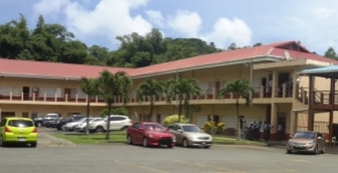
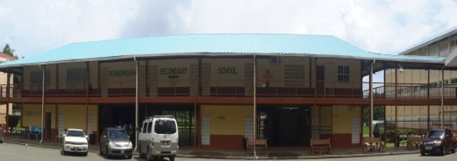
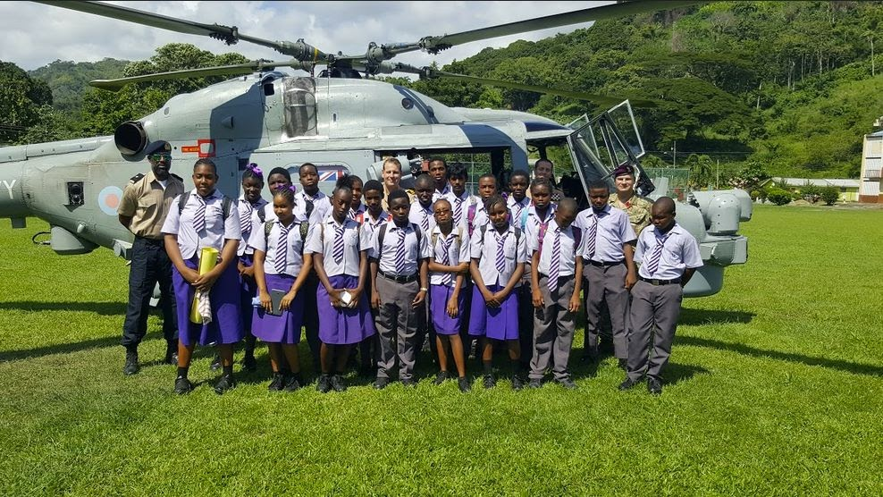

Slide 36
Roxborough Secondary School
Principal
Vice Principal
Mission
Online Presence
Bloody Bay Road
Roxborough, Tobago
Telephone: 660-4393/299-0779
Established 1965
Mr. Patason Brooks
Mr. Anson James
Holistic development through continued
delivery of relevant curriculum, ongoing staff development, positive parental and community integration and extensive participation in extracurricular and athletic programs at all levels.

Slide 37
Academic Curriculum
Mathematics (Forms 1 - 5)
English Language (Forms 1 - 5)
English Literature (Forms 1 - 5)
Spanish (Forms 1 - 5)
Social Studies (Forms 1 – 5)
Integrated Science (Forms 1 - 5)
Physical Education (Forms 1 - 5)
Visual Arts (Forms 1 -5)
Theatre Arts (Forms 1 - 5)
Music (Forms 1 - 5)
Technology Education (Forms 1, 2 & 3 only)
Geography (Forms 3,4 & 5 only)
Agricultural Science (Forms 4 & 5 only)
Biology & Human and Social Biology (Forms 4 & 5 only)
Chemistry (Forms 4 & 5 only)
Physics (Forms 4 & 5 only)
Information Technology (Forms 4 & 5 only)
Electronic Document Preparation and
Management (Forms 4 & 5 only)
Office Administration (Forms 4 & 5 only)
Principles of Business and Principles of Accounts (Forms 4 & 5 only)
Food and Nutrition (Forms 4 & 5 only)
Garment Construction (Forms 4 & 5 only)
Technical Drawing (Forms 4 & 5 only)
Electrical Installation (Forms 4 & 5 only)
Mechanical Engineering Technology (Forms 4 & 5 only)
History (Forms 4 & 5 only)
Beauty Culture (Forms 4 & 5 only)

Slide 38
Extras
Vision: To be an institution that fosters holistic development of all persons in attendance. Higher education would be partnered with extra-curricular and the athletic, so that students would be positively integrated into society.
01
02
Motto: Love & Service
03
Roxborough Secondary School is strong in technical-vocational programs, offering several Caribbean Vocational Qualification (CVQ) courses.
04
Extracurricular & Special Programs: Football, Cricket, Netball, Basketball, Track and Field, Table Tennis, 4H Club, Drama/Film Club, RBTT Young Leaders, Cadets, Student Council, Spanish Club and
Class Monitors

Slide 39
Guess who attended Roxborough Secondary School!
Navin Stewart,
First-Class Cricketer
1
Johnny King,
Calypsonian
2
Cyd Gray,
Heavyweight Boxer
3

Slide 40
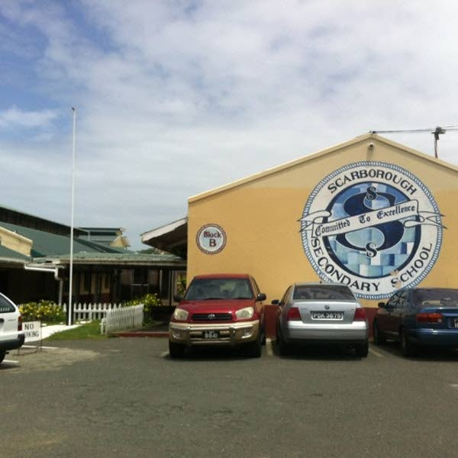
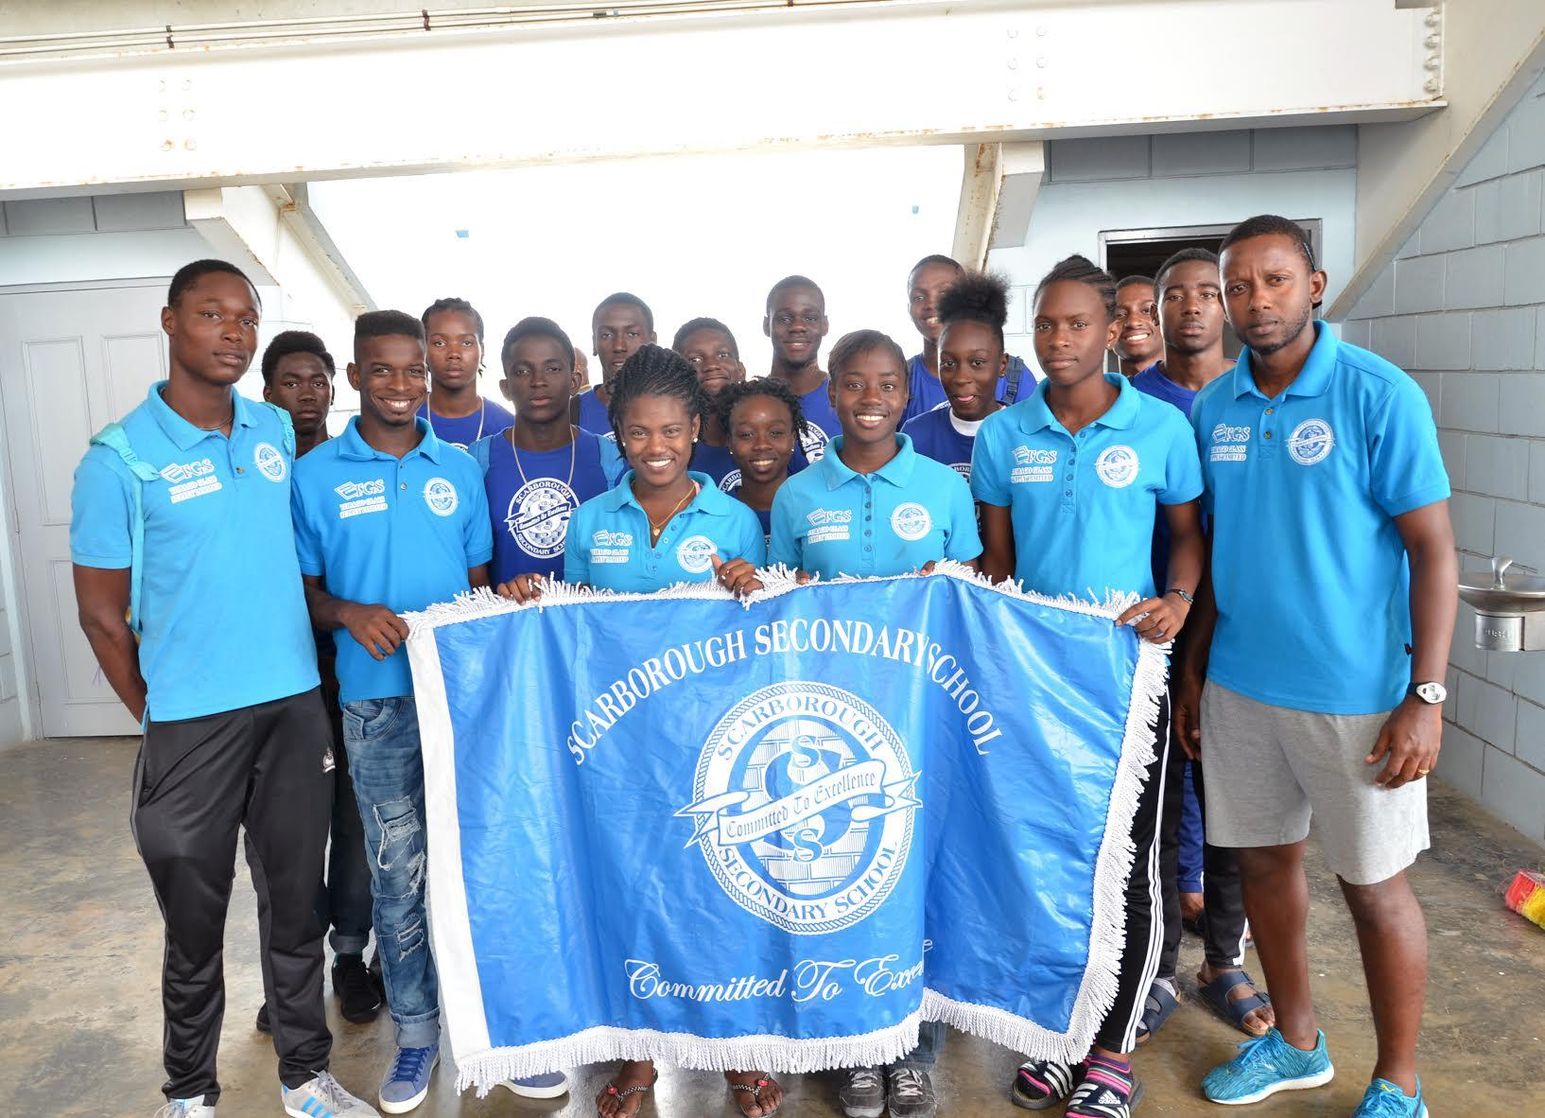
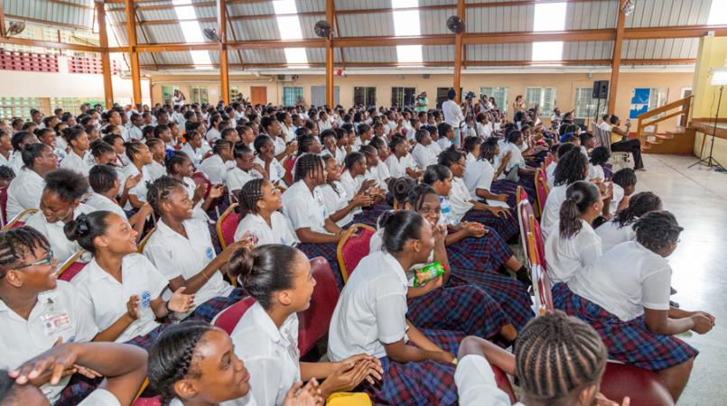

Slide 41
Scarborough Secondary School
Principal
Vice Principal
Mission
Online Presence
26 - 34 Old Government Farm Rd
Shaw Park, Scarborough
Telephone: 285-9121/639-2467
Established 1961
Ms. Althea Alexander
Mrs. Rianne Moses-Peters
Committed to facilitate and foster the all-round development of students to their fullest potential in a safe environment geared to promote excellence, as well as sound moral, spiritual, social and cultural values.

Slide 42
Academic Curriculum
Mathematics (Forms 1 - 6)
Additional Mathematics (Form 6 only)
English (Forms 1 - 5)
English Literature (Forms 4 -6 only)
Information Technology (Forms 1 – 6)
Spanish (Forms 1 - 6)
Social Studies (Forms 1 – 5)
Integrated Science (Forms 1 - 5)
Physical Education (Forms 1 – 6)
Agricultural Science (Forms 4 & 5 only)
Accounts (Form 6 only)
Art and Design (Form 6 only)
Biology and Physics (Forms 4 – 6 only)
Caribbean Studies (Form 6 only)
Chemistry (Forms 4 & 5 only)
Clothing and Textile (Forms 4 & 5 only)
Communication Studies (Form 6 only)
Cosmetology (Forms 4 & 5 only)
Crossroads (Forms 1 -3 only)
Economics (Forms 4 – 6 only)
Electronic Document Preparation Management (Forms 4 & 5 only)
Electronic and Electrical Technology (Forms 4 & 5 only)
Environmental Science (Form 6 only)
Food and Nutrition (Forms 4 - 6 only)
Geography (Forms 4 – 6 only)
Geometric and Mechanical Engineering Drawing (Form 6 only)

Slide 43
Academic Curriculum
History (Forms 4 & 5 only)
Human and Social Biology (Forms 4 & 5 only)
Management of Business (Form 6 only)
Mechanical and Engineering Technology (Forms 4 & 5 only)
Music (Forms 4 & 5 only)
Physics (Forms 4 – 6 only)
Principles of Business (Forms 4 & 5 only)
Principles of Accounts (Form 3 – 5 only)
Sociology (Form 6 only)
Technical Drawing (Forms 4 & 5 only)
Technology Education (Forms 1 – 3 only)
Theatre Arts (Forms 4 & 5 only)
Tourism (Form 6 only)
Visual and Performing Arts (Forms 1 – 3 only)
Visual Arts (Forms 4 & 5 only)

Slide 44
Please Note
Scarborough Secondary School is strong in cultural and sport programs. Students must enroll in at least two disciplines, at least one of which should be in the area of Civic/Service.
SPORTS/CULTURE
Basketball, Cricket, Football, Gymnastics, Netball, Swimming, Volleyball, Badminton, Chess, Fitness, Scrabble, Table Tennis, Dance, Folk Choir, Classical Choir, Debate/Literary Club, Drama, Musical Instruments, Steelband
CIVIC/SERVICE
Cadets, Scouting, Inter School Christian Fellowship (ISCF), Girl Guides, Interact, Health Club, Credit Union, Peer Counselling, Environment Club, UNESCO, Axis

Slide 45
Extras
Vision: To be a premier institution which provide learning
experiences conducive to the holistic development of literate, critical
thinkers, problem solvers and lifelong learners who are able to
contribute effectively in a changing global environment.
01
02
Motto: Committed to Excellence
03
Scarborough Secondary School Sixth Form and Caribbean Vocational
Qualification (CVQ) courses
04
Academic & Special Programs: Student Council, Prefects and
Class Monitors, Sixth Form, Caribbean Vocational
Qualification (CVQ) courses

Slide 46

Guess who attended Scarborough Secondary School!
Akeem Stewart,
Olympic Athlete
1
Renny Quow,
National Track & Field Athlete
2
The Honourable Shamfa Cudjoe,
Member of Parliament
3

Slide 47
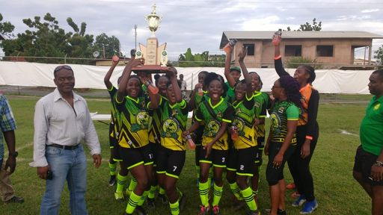
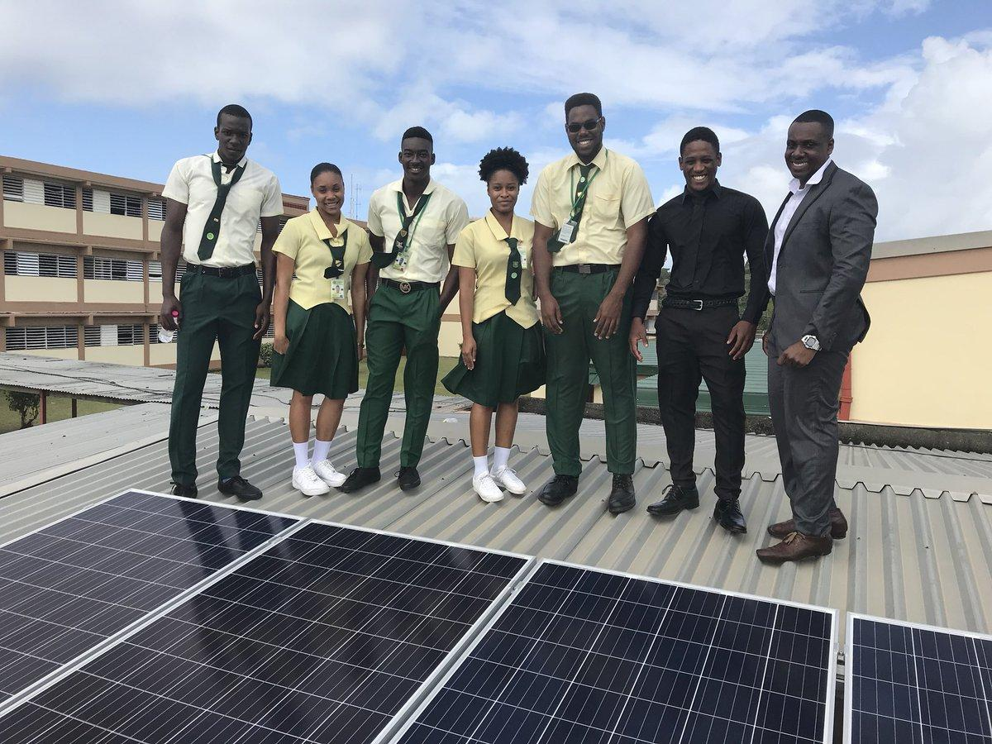
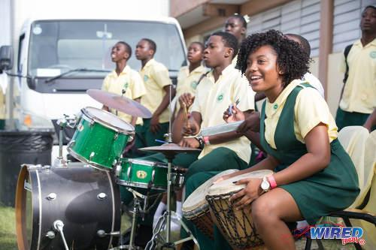
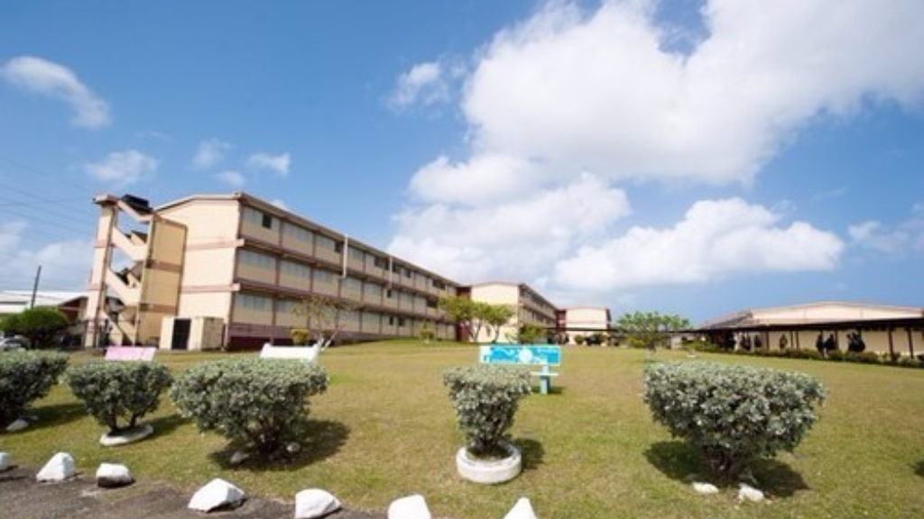

Slide 48
Signal Hill Secondary School
Principal
Vice Principal
Mission
Online Presence
Signal Hill Road
Signal Hill, Tobago
Telephone: 285-9120/639-3407
Established 1977
Mrs. Arianne D’Abreau-Forde
Mr. Xavier King
To empower students of varying aptitudes and talents to become productive and responsible citizens, by delivering to them a diverse and well-balanced curriculum.

Slide 49
Academic Curriculum
Mathematics (Forms 1 - 5)
English Language (Forms 1 - 5)
English Literature (Forms 1 - 6)
Spanish (Forms 1 - 5)
Social Science (Forms 1 – 3 only)
Social Studies (Forms 4 & 5 only)
Integrated Science (Forms 1 – 3 only)
Physical Education (Forms 1 - 6)
Visual and Performing Arts ( Forms 1 - 3 only)
Visual Arts (Forms 4 & 5 only)
Theatre Arts (Forms 4 & 5 only)
Performing Arts (Form 6 only)
Music (Forms 4 & 5 only)
Technology Education (Forms 1, 2 & 3 only)
Geography (Forms 3 - 6 only)
Agricultural Science (Forms 4 - 6 only)
Biology (Forms 4 & 5 only)
Human and Social Biology (Forms 4 & 5 only)
Chemistry (Forms 4 - 6 only)
Physics (Forms 4 - 6 only)
Information Communication Technology (Forms 1 - 3 only)
Moral Education (Forms 1 – 3 only)
Business Studies (Form 3 only)
Economics (Forms 4 - 6 only)
Office Administration (Forms 4 & 5 only)
Principles of Business (Forms 4 & 5 only)
Principles of Accounts (Forms 4 & 5 only)

Slide 50
Academic Curriculum
Food and Nutrition (Forms 4 - 6 only)
Clothing & Textiles (Forms 4 & 5 only)
Technical Drawing (Forms 4 & 5 only)
Electrical Installation (Forms 4 & 5 only)
Mechanical Engineering Technology (Forms 4 & 5 only)
History (Forms 4 - 6 only)
Building Technology (Forms 4 & 5 only)
Cosmetology (Forms 4 & 5 only)
Electrical Document Preparation & Management (EDPM) (Forms 4 & 5 only)
Additional Mathematics (Form 4 & 5 only)
Pure Mathematics (Form 6 only)
Computer Science (Form 6 only)
Art and Design (Form 6 only)
Electrical and Electronic Technology (Forms 4 - 5 only)
Communication Studies (Form 6 only)
Caribbean Studies (Form 6 only)
Sociology (Form 6 only)
Accounting (Form 6 only)
Management of Business (Form 6 only)
Entrepreneurship (Form 6 only)
Environmental Science (Form 6 only)
Building Mechanical Engineering (BMED) (Form 6 only)
Tourism (Form 6 only)

Slide 51
Extras
Signal Hill Secondary School has strong programs in: Science and Technology, Business, Music, Dancing and Performing Arts; Visual Arts, Craft and Design.
01
02
Motto: Readiness is the key
Vision: To be the premier institution for the provision of world class, holistic secondary and vocational education in a changing global environment.
03
04
Extracurricular (Sports): Football, Netball, Track & Field, Basketball, Cricket, Swimming, Hockey, Table Tennis

Slide 52
Extras
05
Extracurricular (Perfoming Arts): Art, Choir, Drama, Music, Steel Band
Student Organizations: Student Council, Prefects, Axis Club, Ballroom Dancing, Capoeira, Chess Club, Drama Club, Environmental Club, ISCF, Scrabble Club, Tourism Club
06
07
Special Groups: Boys to Men, Cadets
08
Signal Hill Secondary School also has a Sixth Form program and offers Caribbean Vocational
Qualification (CVQ) courses.

Slide 53

Guess who attended Signal Hill Secondary School!
Tyriq Horsford,
National Track & Field Athlete
1
Natoyia Joefield,
Entrepreneur
2
Charlotte Wilson,
Multi-Platinum
K-Pop Songwriter & Producer
3

Slide 54
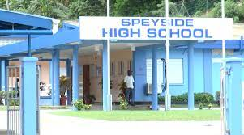
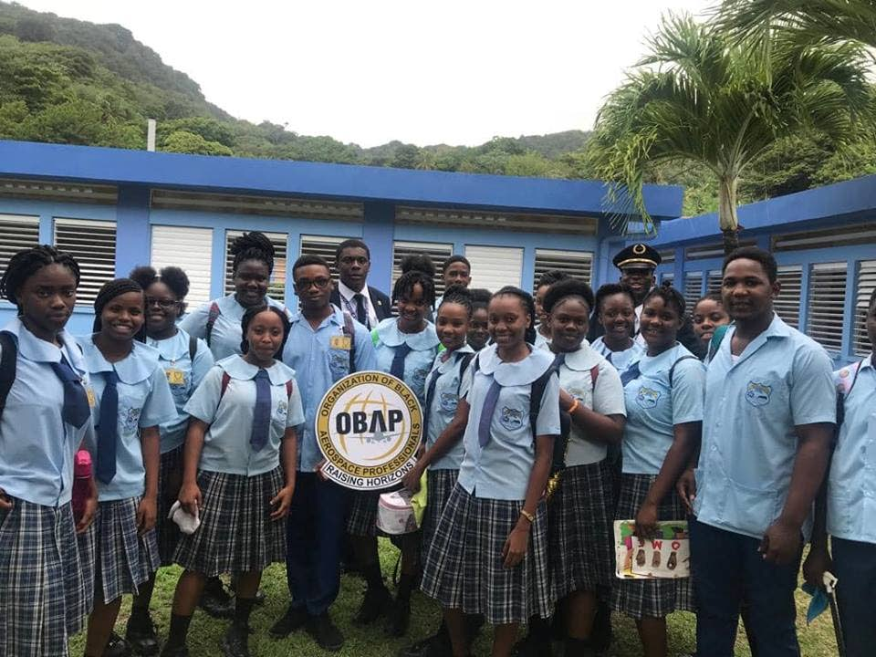
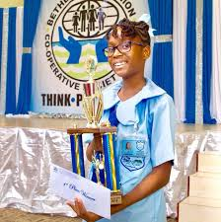
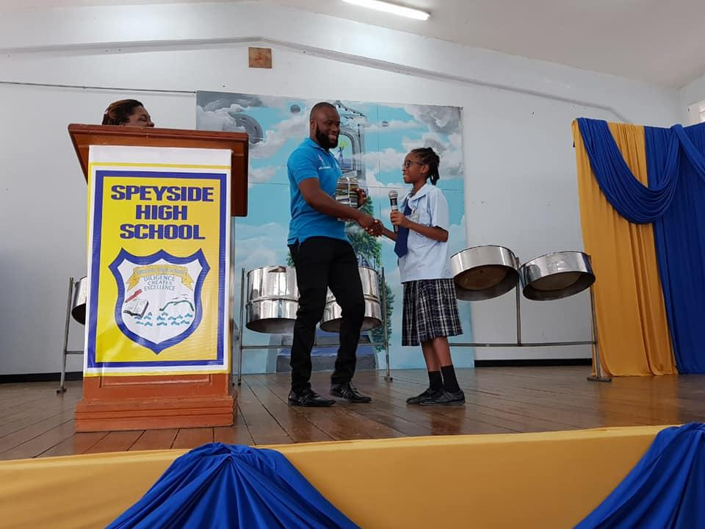

Slide 55
Speyside High School
Principal
Vice Principal
Mission
Online Presence
Lucy Vale
Speyside, Tobago
Telephone: 660-4201/6150
Established 2003
Mr. Alson Sylvester
Mr. Dale Peters
To facilitate the holistic development of our students through a relevant and dynamic curriculum that will create lifelong learners who will contribute to an ever-changing world.

Slide 56
Academic Curriculum
Mathematics (Forms 1 – 6)
English Language/Literature (Forms 1 – 6)
Social Studies (Forms 1 - 6)
History (Forms 1 – 6)
Integrated Science (Forms 1 – 6)
Agricultural Science (Forms 1 – 6)
Technical Drawing (Forms 1 – 6)
Physical Education (Forms 1 – 6)
Spanish (Forms 1 -3 only)
Visual and Performing Arts (Forms 1 -3 only)
Home Economics (Forms 1 - 3 only)
Moral Education (Forms 1 -3 only)
Library (Forms 1 – 3 only)
Geography (Forms 4 – 6 only)
Principles of Business (Forms 4 – 6 only)
Principles of Accounts (Forms 4 - 6 only)
Biology (Forms 4 – 6 only)
Human and Social Biology (Forms 4 – 6 only)
Chemistry (Forms 4 - 6 only)
Physics (Forms 4 – 6 only)
Information Technology (Forms 4 -6 only)
Food and Nutrition (Forms 4 – 6 only)
Clothing and Textiles (Forms 4 – 6 only)
Electronics (Forms 4 – 6 only)
Electronics Document Preparation and
Management (Forms 4 – 6 only)
Office Administration (Forms 4 – 6 only)
Music (Forms 4 – 6 only)

Slide 57
Extras
01
Student Clubs/Organization: Cadets, Reading/Debating Club, Abstinence Club, Scrabble Club, Environment Club, 4H Club, Visual and Performing Arts Club, Chess Club, Sports Club, Audio Visual Club, Clothing Club, Culinary Club
02
Special Programs: Speyside Secondary School is strong in Arts (Visual, Performing & Cultural)
Vision: To become an institution that is committed to providing quality education in a caring and disciplined environment
03
04
Speyside High School offers a Sixth Form academic program.

Slide 58

Guess who attended Speyside High School!
Abigail Jose-Ann Hackett,
Lawyer
1
Konnel Jacob,
National Track & Field Athlete
2
Zakiya Denoon,
National Track & Field Athlete
3

Slide 59
Remember...
...your journey has just begun!
2021
Leaving Primary School
2026
Secondary School Graduation

Slide 60
Thanks!
Do you have any questions?
Contact your school’s Guidance Counsellor or the
Student Support Services Unit at
Phone: (868) 299-0781; Ext: 3114-3116
Checkout the Divison of Education, Research and Technology’s Facebook Page below:
/thadert

Slide 61
Credits
Vectors
Back to school landing page
Back to school landing page
Back to school home page template
Back to school landing page template
Back to school landing page
Back to school landing page
Back to school landing page concept
Icons
Literature Icon Pack
Photos
Set of books and ladders
Copy-space opened books on table

